Slide 1
Elucidating the immune active state of HR+HER2- MammaPrint High 2 early breast cancer
Erin Frances Cobain¹, Lajos Pusztai², Cathy Lynne Graham³, Pat W. Whitworth⁴, Peter D. Beitsch⁵, Cynthia R. C. Osborne⁶, Rakhshanda Layeequr Rahman⁷, Nathalie M. Johnson⁸, Adam Brufsky⁹, Reshma L. Mahtani¹⁰, VK Gadi¹¹, Kent Hoskins¹¹, Hannah M. Linden¹², Rita A. Mukhtar¹³, Laura Esserman¹⁴, Josien Haan¹⁵, Katie Quinn¹⁶, Andrea Menicucci¹⁶, William Audeh¹⁶, Joyce O'Shaughnessy¹⁷, FLEX Investigators Group
¹University of Michigan, Ann Arbor, MI; ²Yale Cancer Center, Yale School of Medicine, New Haven, CT; ³Emory University School of Medicine, Atlanta, GA; ⁴Nashville Breast Center, Nashville, TN; ⁵Dallas Surgical Group, Dallas, TX; ⁶Texas Oncology-Baylor Charles A. Sammons Cancer Center, The US Oncology Network, Dallas, TX; ⁷Texas Tech University Health Sciences Center School of Medicine, Lubbock, TX; ⁸Legacy Health System, Portland, OR; ⁹University of Pittsburgh, Pittsburgh, PA; ¹⁰Miami Cancer Institute, Baptist Health South Florida, Miami, FL; ¹¹University of Illinois Chicago, Chicago, IL; ¹²University of Washington, Fred Hutchison Cancer Research Center, Seattle, WA; ¹³University of California, San Francisco, San Francisco, CA; ¹⁴Department of Surgery, University of California, San Francisco, San Francisco, CA; ¹⁵Agendia, Amsterdam, Netherlands; ¹⁶Medical Affairs, Agendia Inc., Irvine, CA; ¹⁷Baylor University Medical Center, Texas Oncology, The US Oncology Network, Dallas, TX

Slide 2
Key Takeaway Points/Conclusions:
MammaPrint H2 tumors exhibit a heightened immune active state compared to MammaPrint H1 tumors among hormone receptor positive (HR+), HER2-negative (HER2-) early-stage breast cancers
The presence of immune cells and upregulation of genes involved in antigen presentation, which are critical in eliciting T- and B-cell activation, may explain improved response rates to immunotherapy observed in MammaPrint H2 tumors
Selecting patients with HR+ HER2- early-stage breast cancer for immunotherapy treatment based on grade or percent estrogen receptor positivity (ER%) alone may exclude patients likely to benefit. Conversely, patients with high grade tumors that are not MammaPrint H2 may be at risk of toxicities associated with overtreatment
These data support the ongoing SWOG2206 clinical trial in evaluating the impact of neoadjuvant chemo-immunotherapy on rates of pathologic complete response and invasive disease-free survival in HR+ HER2- early-stage breast cancer with MammaPrint H2 tumors

Slide 3
Neoadjuvant immunotherapy in HR+HER2- breast cancer
Patients with clinically and genomically high-risk HR+HER2- breast cancer continue to have 20% recurrence risk despite current adjuvant therapies (i.e., chemotherapy [CT], CDK4/6i)
The addition of immune checkpoint inhibitors to neoadjuvant CT in HR+HER2- breast cancer has been evaluated in Phase III clinical trials (CheckMate-7FL and KEYNOTE-756)
These trials used clinical stage, tumor grade (grade 3), or ER% (≤ 10%) to select patients with high risk for recurrence for treatment on study
Genomic classifiers predicting recurrence risk, such as MammaPrint® 70-gene signature, may offer enhanced precision in identifying HR+HER2- breast cancer patients who benefit from chemotherapy and immune checkpoint therapy
References: Loi et al. Ann Oncol 2023; Cardoso et al. Ann Oncol 2023

Slide 4
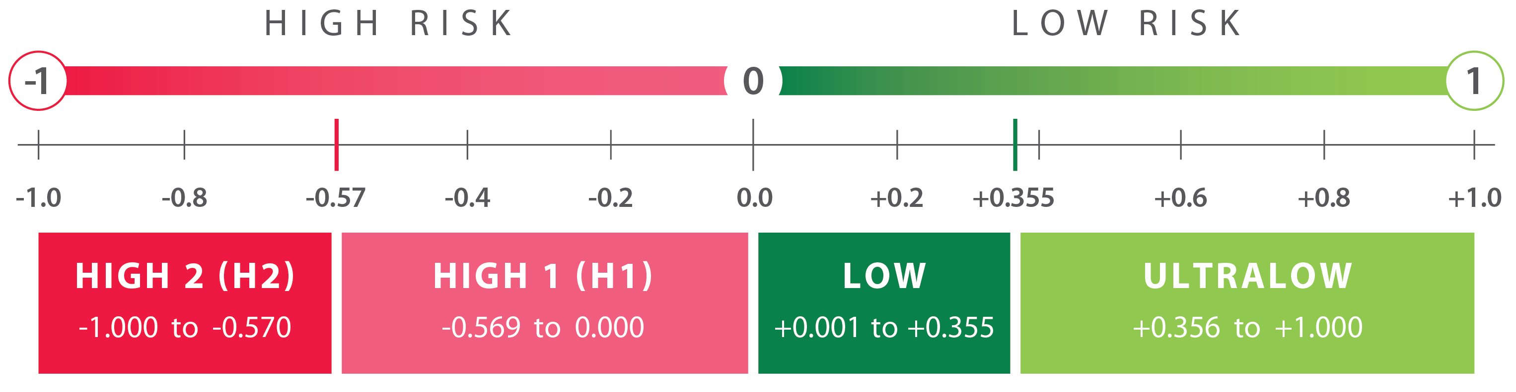
70-gene MammaPrint test: Implications for ET and CT Decisions
MammaPrint (MP) classifies patients with HR+HER2- early breast cancer as having an Ultra Low, Low, High 1, or High 2 Risk of distant recurrence
Additional Recent
High 2 Findings
Abstract Title: Association of MammaPrint index and 3-year outcome of patients with HR+HER2- early-stage breast cancer treated with chemotherapy with or without anthracycline
(Neo)Adjuvant CT benefit
ET benefit 0-5 yrs
Increased sensitivity to: PARPi, IO, Platinum
(Neo)Adjuvant CT benefit
ET benefit 0-5 yrs
No increased sensitivity to PARPi, IO, Platinum
No CT benefit
ET benefit 0-5 yrs
EET benefit 6-10 yrs
No CT benefit
ET benefit years <5 yrs
O’Shaughnessy et al., Rapid Oral
# 511, 5/31 2:45-4:15pm
Knauer, NBRST, STO-3, I-SPY2
Knauer , NBRST, STO-3, I-SPY2
MINDACT, STO-3,
NSABP-B42, IDEAL
MINDACT, STO-3
References: Knauer (Breast Cancer Res Treat 2010), NBRST (Whitworth, Ann Surg Oncol 2022), STO-3 (van’t Veer, Breast Cancer Res Treat, 2017, Esserman, JAMA Onc 2017), I-SPY2 (https://www.ispytrials.org/i-spy-platform/i-spy2; Pusztai, Cancer Cell 2021), MINDACT (Piccart, Lancet Oncol, 2021; Lopes Cardozo, JCO, 2022), NSABP-B42 (Rastogi, ASCO 2021), IDEAL (Liefers, SABCS 2022)

Slide 5
MammaPrint High 2 and neoadjuvant immunotherapy
I-SPY2 trials demonstrated improved pCR when immune checkpoint inhibitors were included with neoadjuvant chemotherapy (nCT) in MP High 2, HR+HER2- tumors
Immunotherapy (IO) arm | pCR% in control (nCT) and IO
 | High 1 |  |  | High 2
 | Control | IO | Δ | Control | IO | Δ
Pembrolizumab | 13% | 18% | 5% | 21% | 61% | 40%
Pembrolizumab + SD-101 | 10% | 17% | 7% | 21% | 45% | 24%
Durvalumab + Olaparib | 9% | 10% | 1% | 22% | 66% | 44%
The currently enrolling phase III randomized trial SWOG S2206 (NCT06058377) assigns patients with ER+HER2-, MP High 2 breast cancer to durvalumab + nCT vs nCT alone
Reference: Nanda et al., JAMA Oncol, 2020; Wolf et al., Cancer Res, 2022; Pusztai et al., Cancer Cell 2021

Slide 6
S2206 Schema
Clinical Stage II-III Hormone Receptor Positive, HER2-Negative Breast Cancer
Patients Consent to MammaPrint Testing, Discussion of Potential Participation in the Trial
SOC MammaPrint Testing Available and High 2 (score -0.57 to -1)
Physician and Patient Discuss Randomization
STEP 1 Registration (Screening) and MammaPrint Testing
STEP 1 Registration
MammaPrint High 2 (score -0.57 to -1)
MammaPrint High 1 or Low Risk
STEP 2: Randomization
Not Eligible for Study
1:1
Arm 1: SOC Chemotherapy (AC-T)
Arm 2: SOC Chemotherapy (AC-T) + Durvalumab
SOC Surgery, Radiation (if indicated), Endocrine Therapy (+/- Targeted Therapy)
Follow Up Period: 10 years

Slide 7
Study Objective
Characterize the underlying biology that mediates immune therapy response in HR+HER2- early breast cancers classified as MammaPrint High 2, an immunotherapy biomarker in SWOG 2206, using the FLEX Study
Characterize clinicopathologic features associated with MammaPrint High 2
Evaluate gene expression levels to define immune biology in High 2 (BluePrint Luminal and Basal subtypes) vs High 1 tumors
Innate and adaptive immunity cell types
Antigen processing and presentation pathway
Immune checkpoint PD-1 and PD-L1 expression

Slide 8
Study Overview
FLEX (NCT03053193) is a prospective real world evidence study designed to support investigator-initiated breast cancer research through the curation of paired full transcriptome and clinical data.
Enrolls stage I-III breast cancer patients who receive standard of care MammaPrint

Slide 9
Methods
Patients: 2916 patients from FLEX with MammaPrint High Risk, HR+HER2- early breast cancer
Molecular Classification:
MammaPrint High Risk tumors stratified into High 1 (Index 0.00 to -0.569) or High 2 (Index -0.570 to -1.00)
80-gene molecular subtyping signature, BluePrint, further classified High Risk tumors as Luminal-Type or Basal-Type
Immune characterization of High 2 relative to High 1
Immune Cell abundances were defined by the gene-signature based method, xCell, and differences were determined by t-test (adjusted p-value <0.05)
Gene expression of the KEGG pathway genes “antigen processing and presentation” and the expression of PD-1 and PD-L1 between High Risk groups was determined by use of the R package Limma
References: Aran et al., Genome Biology 2017; Ritchie et al., Nucleic Acids Research 2015.

Slide 10
Clinical Characteristics
Characteristic, n (%)* *unknown excluded | MP High1 (n=2292) | MP High2 (n=624) | P-value
Age
≤ 50 yrs | 537 (23.6%) | 198 (31.9%) | <0.001
> 50 yrs | 1739 (76.4%) | 423 (68.1%) | 0.131
Menopausal Status
Pre-/Peri- | 475 (22.0%) | 170 (29.2%) | <0.001
Post- | 1689 (78.1%) | 412 (70.8%)
Race
White | 1778 (82.4%) | 404 (69.9%) | <0.001
Black | 229 (10.6%) | 112 (19.4%)
Latin American | 72 (3.3%) | 34 (5.9%)
AAPI | 67 (3.1%) | 25 (4.3%) | 0.587
Other | 12 (0.6%) | 3 (0.5%)
T Stage
T1 | 943 (62.3%) | 199 (45.2%) | <0.001
T2 | 493 (32.6%) | 199 (45.2%)
T3 | 55 (3.6%) | 27 (6.1%)
T4 | 22 (1.5%) | 15 (3.4%)
N Stage
Node Negative | 1156 (80.4%) | 313 (74.2%) | 0.021
Node Positive | 282 (19.6%) | 109 (25.8%)
Grade
G1 | 361 (16.4%) | 10 (1.6%) | <0.001
G2 | 1346 (61.1%) | 163 (26.7%)
G3 | 495 (22.5%) | 437 (71.6%)
ER% Staining
1-10% | 25 (1.1%) | 95 (16.8%) | <0.001
>10% | 2213 (98.9%) | 470 (83.2%)
BP Molecular Subtype
Luminal B | 2269 (99.0%) | 348 (55.8%) | <0.001
Basal | 23 (1.0%) | 276 (44.2%)
79% of tumors were MP High 1
21% of tumors were MP High 2
Patients with MP High 2 tumors more likely to be younger compared to High 1
MP High 2 more likely to be grade 3
30% of MP High 2 were Grade 1-2
53% of all Grade 3 were MP High 1
MP High 2 tumors more likely to have low ER staining
83% of High 2 tumors had ER% >10%

Slide 11
MammaPrint High 2 tumors have increased innate immunity
MP High 2 tumors had significantly higher abundance of antigen presenting cells (APCs) compared to MP High 1 tumors:
M1 macrophages
Activated Dendritic Cells
Compared to MP High 1, MP High 2 tumors had:
Higher abundance of NK cells
Significantly lower abundance of neutrophils
****p<0.0001

Slide 12
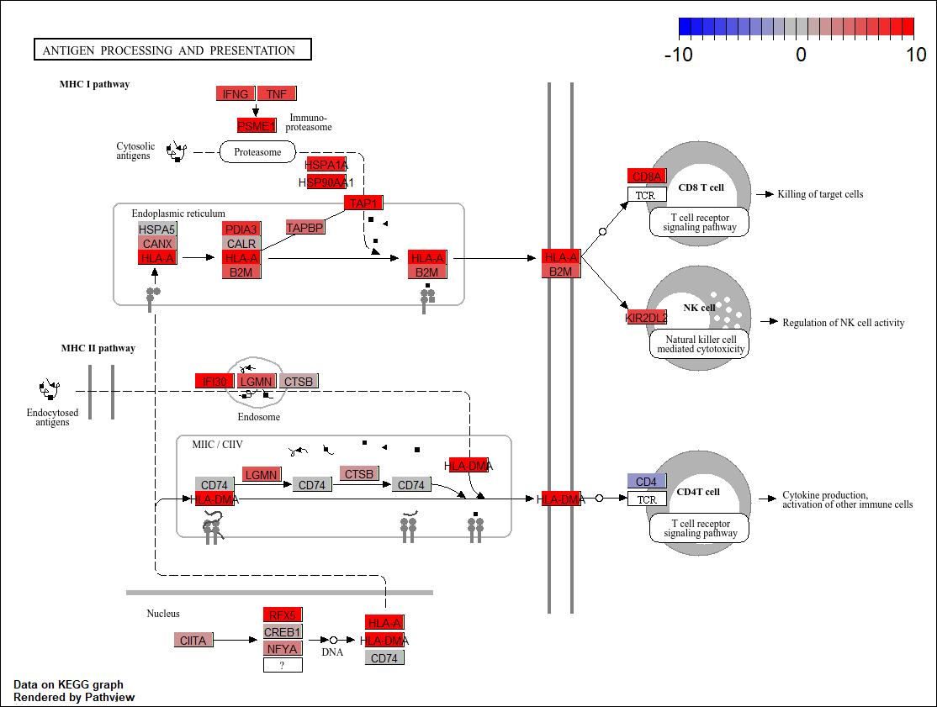
Upregulation of antigen presentation and processing in MammaPrint High 2 vs High 1
MHC I
Pathway
KEGG Pathway: Antigen Presentation and Processing.
Genes involved in MHC I pathway and MHC II pathway were upregulated (red) in MP High 2 tumors compared to MP High 1 tumors
MHC II
Pathway

Slide 13
Upregulation of PD-1 and PD-L1 expression in MP High 2
****p<0.0001
MP High 2 tumors had significantly higher expression of PD1 and PD-L1 compared to MP High 1 tumors

Slide 14
MammaPrint High 2 tumors have increased adaptive immunity
Compared to MP High 1, MP High 2 tumors had significantly higher frequency of:
CD4+ T and Memory cells
CD8+ T and Memory cells
B cells, memory B cells and antibody producing plasma cells
Increased lymphocytes were observed in both MP High 2 Luminal and Basal tumors
****p<0.0001; **p<0.01; *p<0.05

Slide 15
Conclusions:
MammaPrint H2 tumors exhibit a heightened immune active state compared to MammaPrint H1 tumors among hormone receptor positive (HR+), HER2-negative (HER2-) early-stage breast cancers
The presence of immune cells and upregulation of genes involved in antigen presentation, which are critical in eliciting T- and B-cell activation, may explain improved response rates to immunotherapy observed in MammaPrint H2 tumors
Selecting patients with HR+ HER2- early-stage breast cancer for immunotherapy treatment based on grade or percent estrogen receptor positivity (ER%) alone may exclude patients likely to benefit. Conversely, patients with high grade tumors that are not MammaPrint H2 may be at risk of toxicities associated with overtreatment
These data support the ongoing SWOG2206 clinical trial in evaluating the impact of neoadjuvant chemo-immunotherapy on rates of pathologic complete response and invasive disease-free survival in HR+ HER2- early-stage breast cancer with MammaPrint H2 tumors

Slide 16
Acknowledgements
We would like to thank the >16,000 patients enrolled in FLEX that make these data possible
FLEX study site investigators, coordinators, research nurses and personnel
FLEX Trial Information
MammaPrint, BluePrint, and Full-genome Data Linked With Clinical Data to Evaluate New Gene EXpression Profiles (FLEX) (NCT03053193)
Agendia, Inc.

