Slide 1
Association of MammaPrint index and 3-year outcome of patients in the FLEX Registry trial with HR+HER2- early-stage breast cancer treated with chemotherapy with or without anthracycline
Joyce O'Shaughnessy¹, Cathy Lynne Graham², Pat Whitworth³, Peter D. Beitsch⁴, Cynthia R. C. Osborne⁵, Rakhshanda Layeequr Rahman⁶, Eric Allen Brown⁷, Linsey P. Gold⁷, Nathalie McDowell Johnson⁸, Adam Brufsky⁹, Harshini Ramaswamy¹⁰, Nicole Stivers¹⁰, Andrea Menicucci¹⁰, William Audeh¹⁰, FLEX Investigators' Group
¹Baylor University Medical Center, Texas Oncology, The US Oncology Network, Dallas, TX; ²Emory University, Atlanta, GA; ³Nashville Breast Center, Nashville, TN; ⁴Dallas Surgical Group, Dallas, TX; ⁵Texas Oncology PA, Dallas, TX; ⁶Texas Tech University Health Sciences Center School of Medicine, Lubbock, TX; ⁷Comprehensive Breast Care, Troy, MI; ⁸Legacy Health System, Portland, OR; ⁹University of Pittsburgh, Pittsburgh, PA; ¹⁰Medical Affairs, Agendia, Inc., Irvine, CA

Slide 2
Lead with the End: Conclusions
In the real-world FLEX Registry trial, patients with MammaPrint High 2, BluePrint Luminal B, HR+ HER2- EBC have higher 3-yr RFS rate with AC-T than with TC therapy (non-randomized)
AC-T-treated High 1 and High 2 patients were significantly more likely to be premenopausal, node-positive and have larger cancers (adverse prognostic features) than those treated with TC. Thus, some High 1 pts may benefit from AC-T > TC
These real-world data suggest that MammaPrint High 2 HR+ HER2- EBC pts may benefit from the addition of doxorubicin to taxane/cyclophosphamide therapy. However, validation within other studies is needed

Slide 3
Background: Who benefits from adjuvant anthracyclines?
The Anthracyclines in Early Breast Cancer (ABC) Trials showed that docetaxel-cyclophosphamide (TC) was not non-inferior to an anthracycline-based regimen (TaxAC) regarding invasive disease-free survival (IDFS) in high risk HER2- breast cancer
However, benefit from the anthracycline was modest:
1.6% improvement in 5-year IDFS (p = 0.08)
2.8% improvement in 5-year Recurrence-Free Interval (RFI) (p = 0.0003)
5-year RFI with TaxAC vs TC stratified by ER status:
Significant for ER- HER2- breast cancer (HR=1.90 [1.39-2.61]; p < 0.0001)
Non-significant for ER+ HER2- (HR=1.19 [0.96-1.47]; p = 0.11)
Genomic classifiers that predict risk of recurrence may identify subsets of patients with HR+HER2- early breast cancer (EBC) who could benefit from addition of an anthracycline
References: Geyer et al., J Clin Oncol 2024

Slide 4
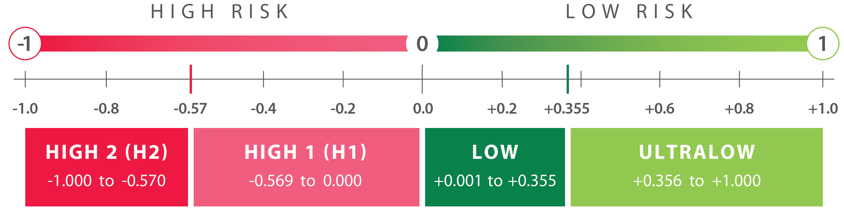
70-gene MammaPrint test: Implications for ET and CT Decisions
MammaPrint classifies patients with HR+HER2- EBC as having an Ultra Low, Low, High 1, or High 2 risk of distant recurrence
(Neo)Adjuvant CT benefit
ET benefit 0-5 yrs
Increased sensitivity to: PARPi, IO, Platinum
(Neo)Adjuvant CT benefit
ET benefit 0-5 yrs
No increased sensitivity to PARPi, IO, Platinum
No CT benefit
ET benefit 0-5 yrs
Extended ET benefit 6-10 yrs
No CT benefit
ET benefit 2 to <5 yrs
Knauer, NBRST,
STO-3, I-SPY2
Knauer, NBRST, STO-3, I-SPY2
MINDACT, STO-3,
NSABP-B42, IDEAL
MINDACT, STO-3
References: Knauer (Breast Cancer Res Treat 2010), NBRST (Whitworth, Ann Surg Oncol 2022), STO-3 (van’t Veer, Breast Cancer Res Treat, 2017; Esserman, JAMA Onc, 2017), I-SPY2 (https://www.ispytrials.org/i-spy-platform/i-spy2; Pusztai, Cancer Cell 2021), MINDACT (Piccart, Lancet Oncol, 2021; Lopes Cardozo, JCO, 2022), NSABP-B42 (Rastogi, ASCO, 2021), IDEAL (Liefers, SABCS, 2022)

Slide 5
MammaPrint High 2 predicts increased chemosensitivity in HR+HER2- Early Breast Cancer
About 1/3 of MP high risk HR+HER2- EBCs are High 2 and 2/3 are High 1
Patients with HR+HER2- EBC were more likely to achieve pCR with neoadjuvant chemotherapy with MP High 2 than with MP High 1 disease (NBRST, Whitworth et al., 2017)
MP High 2 cancers had significantly higher pCR rates compared to MP High 1 cancers
Study | pCR% to neoadjuvant chemotherapy
 | High 1 | High 2 | P-Value
I-SPY2 (Pusztai et al, Cancer Cell, 2021) | 10.0% (n=109) | 22.0% (n=49) | <0.05
NBRST (Beitsch et al, ASCO 2023) | 6.1% (n=198) | 23.3% (n=129) | <0.0001
FLEX (O’Shaughnessy et al, SABCS 2023) | 6.3% (n=142) | 29.2% (n=72) | <0.01
Joyce O’Shaughnessy, MD, Texas Oncology, Sarah Cannon Research Institute

Slide 6
MammaPrint High 2 associated with increased sensitivity to neoadjuvant anthracycline therapy in HR+HER2- EBC in the FLEX Registry Trial
Among High 1 cancers, pCR rates with AC-T/TAC vs TC were comparable
No High 2 cancer (n=10) developed pCR with TC
pCR rate with AC-T/TAC was significantly higher in High 2 compared to High 1 (p<0.001) cancers
Reference: Figure adapted from Audeh et al., 2024, Miami Breast Cancer Conference, Poster #36

Slide 7
Evaluating the association between MammaPrint and anthracycline benefit using real world data
Objective: Evaluate association of MP Index and 3-year Recurrence-Free Survival in HR+HER2- EBC patients treated with taxane and cyclophosphamide (TC) or with anthracycline + taxane (AC-T) chemotherapy (CT)
Methods
FLEX Registry Trial (NCT03053193): Prospective observational study enrolling stage I-III patients whose breast cancers are analyzed for MammaPrint Index and who consent to full somatic genome evaluation and clinical data collection
Patients: 614 patients with HR+HER2- early breast cancer with MP High Risk, BluePrint Luminal B-Type tumors who received CT and had at least 3 years of follow-up since diagnosis. High Risk cancers were classified as High 1 or High 2. Patients treated with SOC CT at physician discretion
Endpoint: Recurrence Free Survival (RFS) defined as time from diagnosis to local-regional recurrence, distant recurrence, or breast cancer-specific death (STEEP 2.0, Tolaney et al., 2021)
Statistical Considerations: Differences in clinical characteristics and 3-year RFS shown using Chi-squared or Fisher’s Exact Test, or Kaplan-Meier analysis and log-rank test, respectively

Slide 8
Characteristics of Luminal MP High Risk HR+ HER2- EBC Patients
Characteristic, n (%) | MP High1 (n=530) | MP High2 (n=84) | Overall (n=614) | P-value
Age (Years)
Mean (SD) | 58 (± 11) | 55 (± 12) | 58 (± 11) | 0.131
Menopausal Status
Post- | 361 (74.3%) | 54 (69.2%) | 415 (73.6%) | 0.618
Pre-/Peri- | 125 (25.7%) | 24 (30.8%) | 149 (26.4%)
Race
White | 410 (81.3%) | 58 (72.5%) | 468 (80.1%) | 0.587
Black | 53 (10.5%) | 12 (15.0%) | 65 (11.1%)
Latin American | 24 (4.8%) | 8 (10.0%) | 32 (5.5%)
AAPI | 14 (2.8%) | 1 (1.3%) | 15 (2.6%) | 0.587
Other | 3 (0.6%) | 1 (1.3%) | 4 (0.7%)
T Stage
T1 | 227 (61.5%) | 27 (45.8%) | 254 (59.3%) | 0.156
T2 | 126 (34.1%) | 25 (42.4%) | 151 (35.3%)
T3 | 14 (3.8%) | 6 (10.2%) | 20 (4.7%)
T4 | 2 (0.5%) | 1 (1.7%) | 3 (0.7%)
N Stage
Node Negative | 275 (78.1%) | 36 (65.5%) | 311 (76.4%) | 0.125
Node Positive | 77 (21.9%) | 19 (34.5%) | 96 (23.6%)
Grade
G1 | 75 (14.9%) | 3 (3.7%) | 78 (13.4%) | <0.001
G2 | 308 (61.4%) | 33 (40.7%) | 341 (58.5%)
G3 | 119 (23.7%) | 45 (55.6%) | 164 (28.1%)
CT Regimen
AC-T/TAC | 184 (34.7%) | 44 (52.4%) | 228 (37.1%) | 0.01
TC | 346 (65.3%) | 40 (47.6%) | 386 (62.9%)
86% of HR+ HER2- MP high risk cancers were MP High 1 (N=530); 14% were MP High 2 (N=84)
Age, menopausal status, race, T stage, and lymph node status were comparable between patients with High 2 vs High 1 tumors
56% of MP High 2 were grade 3 vs 24% of MP High 1
About 1/2 of High 2 pts received AC-T
About 1/3 of High 1 received AC-T
High 1 and High 2 AC-T-treated pts were significantly more likely to be premenopausal, and have higher T and N stage (data not shown)

Slide 9
3-Year RFS in Luminal MP High 1 Patients with AC-T or TC
AC-T
Patients not randomized to TC vs AC-T
TC
Comparable 3-year RFS rates among High 1 tumors treated with TC or with AC-T

Slide 10
3-Year RFS in Luminal MP High 2 Patients with AC-T or TC
AC-T
Patients not randomized to TC vs AC-T
TC
High 2 tumors had worse outcomes treated with TC vs High 2 tumors with AC-T

Slide 11
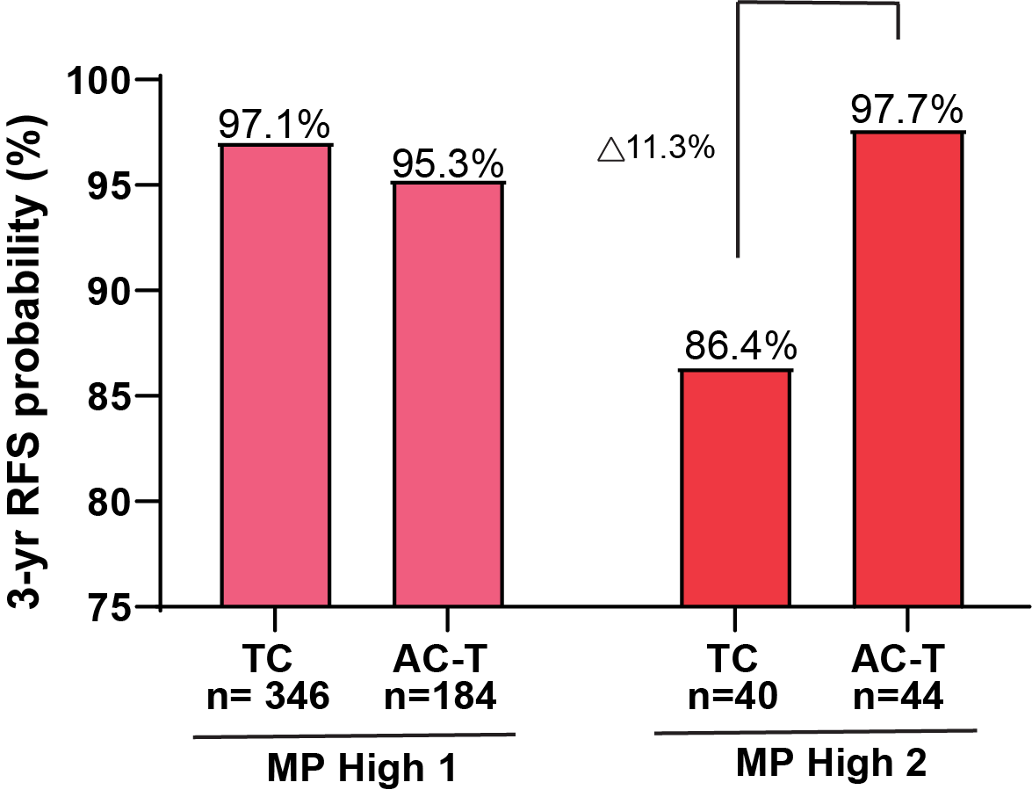
MammaPrint High 2 may be associated with benefit from anthracycline therapy
Chemotherapy Regimen | High 1 | High 2
TC (N=386) | 97.1% (95.1 - 99.2) | 86.4% (74.2 - 100.0)
AC-T/TAC (N=228) | 95.3% (91.8 - 98.8) | 97.7% (93.4 - 100.0)
Difference in 3-yr RFS | -1.8% | 11.3%
Patients not randomized to TC vs AC-T
Similar 3-yr RFS rates for High 1 patients treated with AC-T or TC
Higher 3-yr RFS rate for High 2 patients treated with AC-T than with TC

Slide 12
Conclusions
In the real-world FLEX Registry trial, pts with MammaPrint High 2, BluePrint Luminal B, HR+ HER2- EBC have higher 3-yr RFS rate with AC-T than with TC therapy (non-randomized)
Luminal MP High 1 patients have similar 3-yr RFS rates with adjuvant TC as with AC-T
AC-T-treated High 1 and High 2 patients were significantly more likely to be premenopausal, node-positive and have larger cancers (adverse prognostic features) than those treated with TC. Yet, AC-T-treated High 2 patients had better outcome than TC-treated High 2 pts.
Continued accrual to total of 30,000 EBC patients with 10-years follow-up is planned within the FLEX trial
These preliminary findings are consistent with knowledge of High 2 Biology:
Is similar to TNBC → Rios-Hoyo et al., Poster #573 on 6/2 at 9am
Has immune-activated state → Cobain et al., Oral Session #506 on 6/3 3-6pm
These real-world data suggest that MammaPrint High 2 HR+ HER2- EBC pts may benefit from the addition of doxorubicin to taxane/cyclophosphamide therapy. However, validation within other studies is needed

Slide 13
Acknowledgements
We would like to thank the >16,000 patients enrolled in FLEX Trial to date
FLEX study site investigators, coordinators, research nurses and personnel
FLEX Trial Information
MammaPrint, BluePrint, and Full-genome Data Linked With Clinical Data to Evaluate New Gene EXpression Profiles (FLEX) (NCT03053193)
Agendia, Inc.

